Slide 1
The Outsiders
Steve Randal “Stevie”
Emma, Chayse, and Jaxon

Slide 2
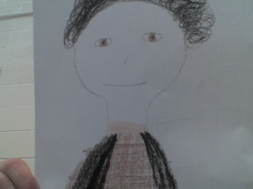

Slide 3
Important information:
Sodapop’s best friend
Works part-time at a gas station
He once held off 4 guys with a busted pop bottle
He doesn’t like Ponyboy
Him and Sodapop do drag races

Slide 4
Physical traits:
He is tall and lean
He has really greasy hair
He combs it into complicated curls

Slide 5
Character traits:
He is 17 years old
He is very cocky, energetic, and smart
Knows a lot about cars
Get into fights a lot

